Slide 1
智覺學苑
Buddhism in Modern Language
at
Pho-Hien Temple
Academy of Wisdom & Enlightenment (AWE)
www.AWE-edu.com
March 23, 2013
1st Term R4
1

Slide 2
Lecture #4.5
Forget-me-not
Inflation and Defence of Ego
www.AWE-edu.com

Slide 3
Characteristics of Ego
Ego has context, structure and relies heavily on identification.
Context identification is conditioned by the environment, upbringing and culture.
Structure is the thought process underlying ego’s identification with form.

Slide 4
Inflation of Ego
THOUGHT ….INFLATED EGO DISTORTS REALITY
Response
Stimuli
THOUGHT
Response
Stimuli
THOUGHT
Response
External Stimuli
THOUGHT

Slide 5
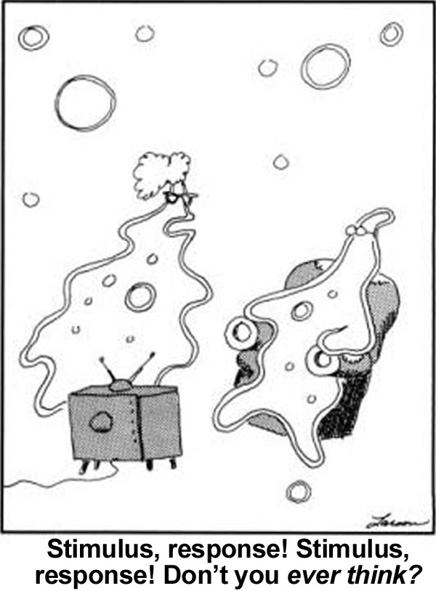
Autopilot
Autopilot
5

Slide 6
Defence of Ego/I/Self
I will not listen….
I do not want to listen to teachings that exceed Self/I. example:
I will not listen to Buddhist teaching that leads to Enlightenment.
I am only happy to listen to sayings that strengthen Self/I. example:
I will live to 100 years old or forever.
I will not listen to the lecture on
counting numbers.
Counting numbers
has nothing to do with Self/I
a waste of my time.

Slide 7
Defense of Self/I/Ego
Listen a little bit won't do much harm, after all I will not understand it anyways.
I have determined that
Self/I will not understand
the deeper meaning of
any teaching. Counting
to ten, hundred, thousands,.......
millions, billion is within my reach. Any larger number is irrelevant to me (I). Called it infinity

Slide 8
Defence of Ego/I/Self
I understand, but Self/I will immediately 'not understand' (unenlightened).
At the lecture, I understand 10^{+n} and 10^{-n}. After the lecture, these power stuffs are useless, no application, i.e. no relevance to me (I).

Slide 9
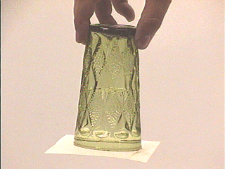
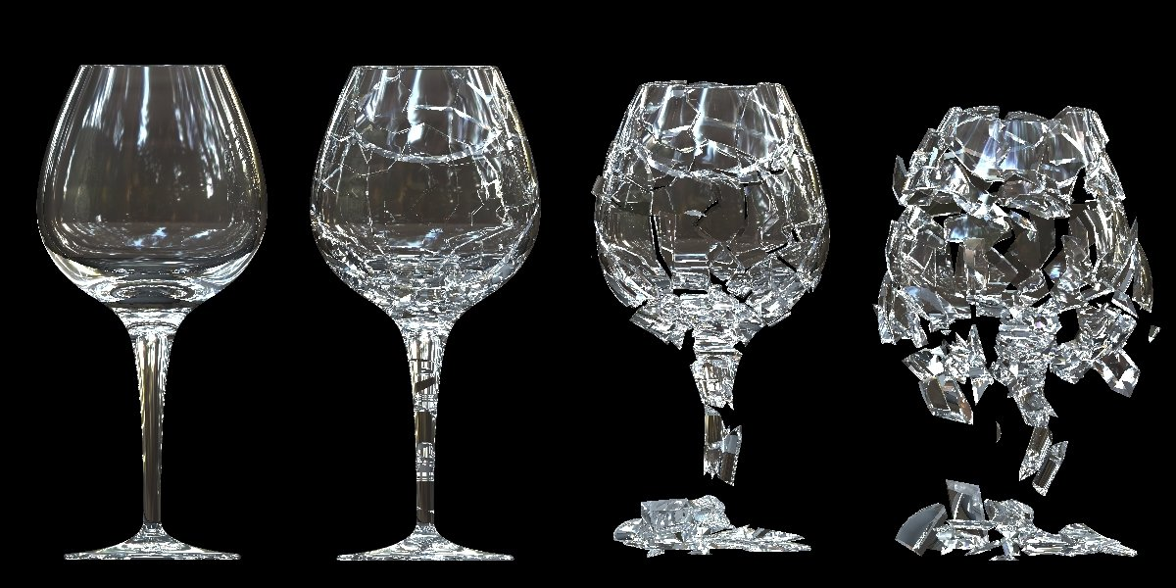
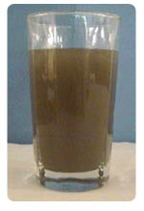
Defense of Self/I/Ego
(1) I won’t listen
(2) No harm in listening. Anyway, I won’t be able to understand
3) I understand but I will immediately forget

Slide 10
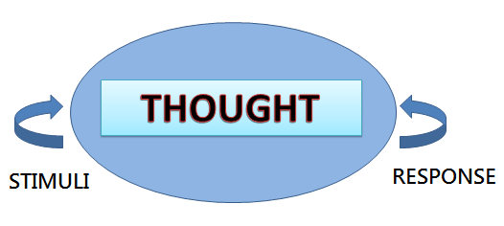
Inflation of Ego
External Stimuli

Slide 11
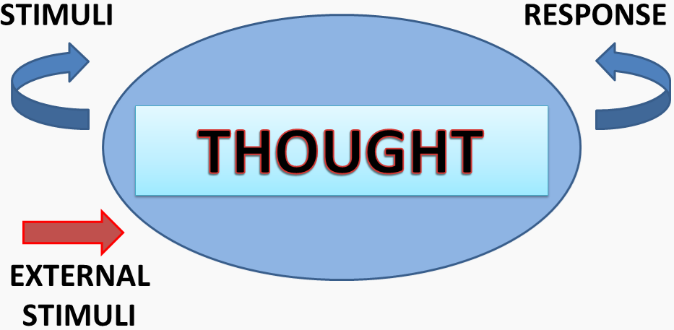
Inflation of Ego

Slide 12
Perils of Ego
5 CARDINAL SINS
IGNORANCE
HOSTILITY / ANGER
GREED
CONCEIT
DOUBT

Slide 13
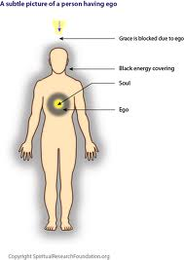
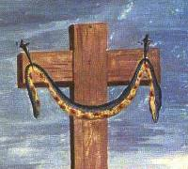
Overcoming Ego
“original sin” in Calvinism

Slide 14
Definitions
Ego = small me = self
When Ego is eliminated, Higher Consciousness appears
Higher Consciousness = Selfless = Unlimited Inspirations = Holy Spirit = Holy Ghost = ~ God

Slide 15
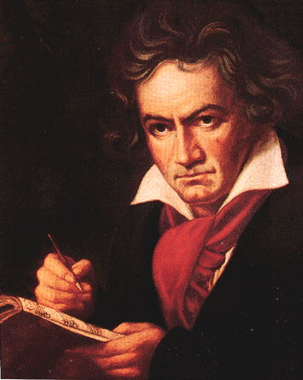
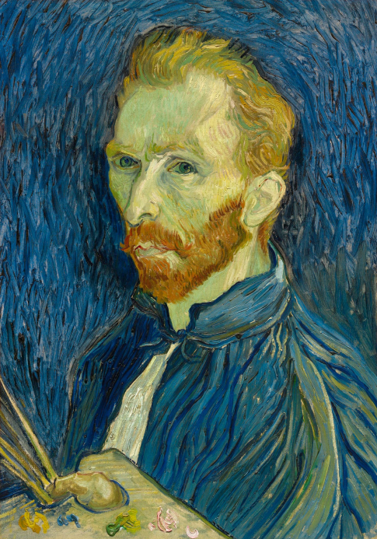
Inspirations
Great art or achievements come from inspirations. Inspirations come from the word inspire (the spirit is in the body)… What spirit? When the holy spirit is in; we become servant of God and create greatness. When the Self/I/Ego is in, we do selfish/hurtful things to satisfy our ego.

Slide 16
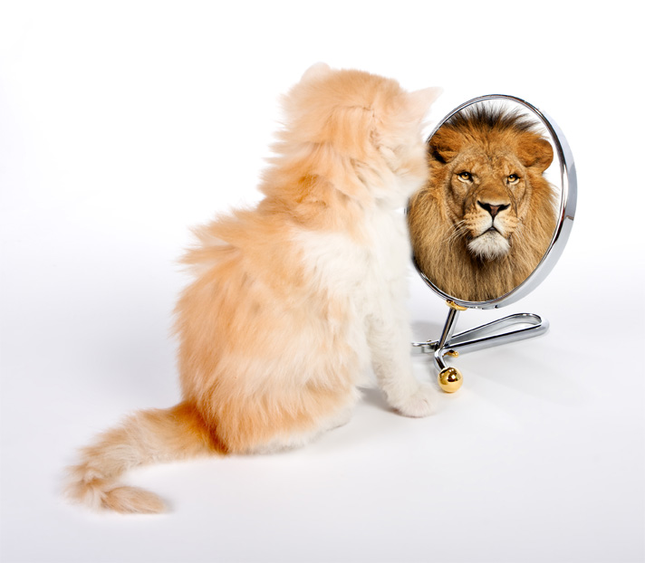
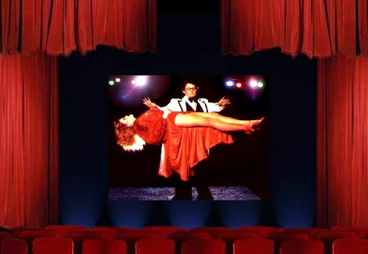
Overcoming Ego
If you can recognize illusion as an illusion, it dissolves. Ego’s survival depends on your perceiving it as reality.

Slide 17
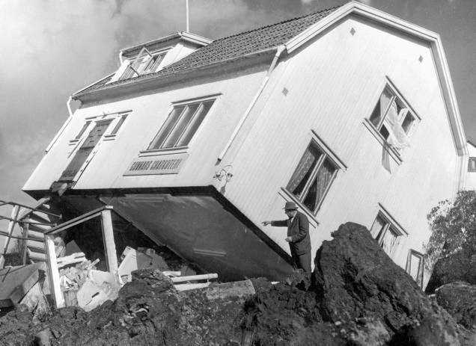
Overcoming Ego
All Structures are unstable. Structure is the thought process underlying ego’s identification with form such as material possession, beauty, fame etc.

Slide 18
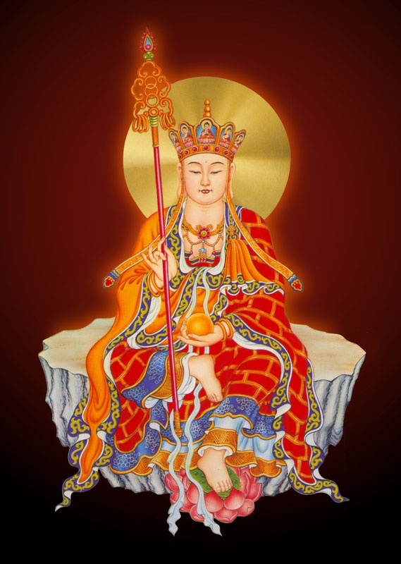
Enlightenment is the Transformation of Ego to a Higher Consciousness
5 CARDINAL SINS
IGNORANCE
HOSTILITY / ANGER
GREED
CONCEIT
UNCERTAINTY / DOUBT
5 ENLIGHTENING TEACHINGS
WISDOM derived from knowledge of the dharma
SERENITY from Presence & Samadhi training
Generosity from DISCIPLINE training
HUMILITY from service & offerings training
CONFIDENCE from training of Correct View and Correct Thinking Mode
Kṣitigarbha Bodhisattva
March 23 2013
18
Notes:
18

Slide 19
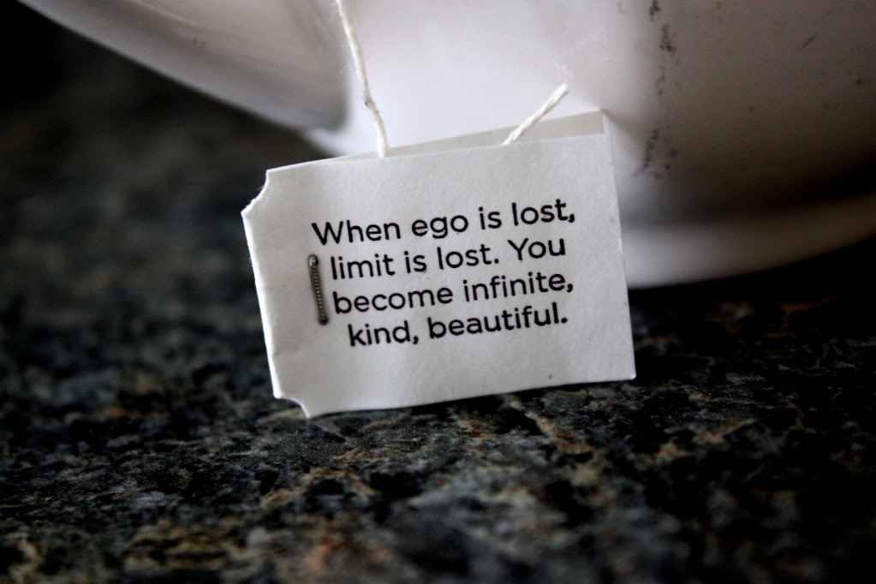
Overcoming Ego

Slide 20
Difference between “ Self” & “Selfless”
Positive aspects | Self ( Asmita) | Selfless (Parmatman)
Thinking mode | limited | unlimited
Thinking capacity | limited | unlimited
Point of view | limited | unlimited
Wisdom | limited | unlimited
Prajna Energy | limited | unlimited
Capability | limited | unlimited
Livelihood | limited | unlimited
Knowledge | limited | unlimited
Living & dying | limited | unlimited

Slide 21
Difference between “ Self” & “Selfless”
Negative aspect | Self ( Asmita) | Selfless (Parmatman)
Affliction | yes | none
Needs | yes | none
Desire | yes | none
Wondering thoughts | yes | none

Slide 22
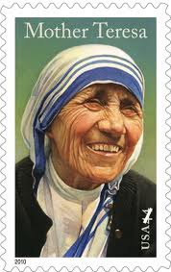
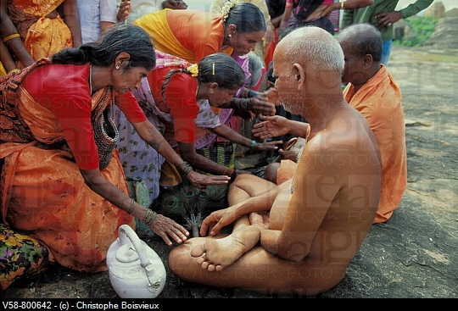
Overcoming Ego
Renouncing of all possession is an ancient spiritual practice in both East and West religions

Slide 23
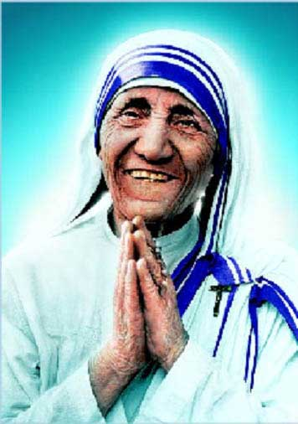
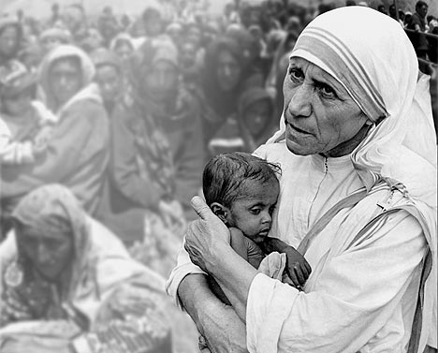
Selfless is Sainthood

Slide 24
Overcoming Ego is NOT altruism
The practice of altruism (self-sacrifice) could facilitate the path to enlightenment
Overcoming Ego is to eliminate one of the two major obstacle to enlightenment
Altruism in animals (videos)

Slide 25
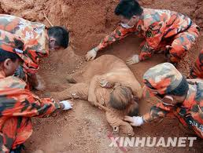
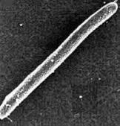
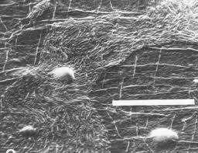
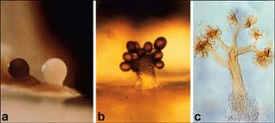
Animal/bacteria altruism
Altruism in nature
http://www.youtube.com/watch?v=bkVhLJLG7ug&feature=related Slime molds live as individual amoebae until starved, they aggregate and sacrifice themselves to form a fruiting body to promote the survival of spores
Notes:
25

Slide 26
Please open the following website in your computer while listening to us
Mother Squirrel Protects Her Young
https://www.youtube.com/watch?NR=1&v=8z8eb9FmOec&feature=endscreen
Dominique Hen Protecting Chicks (Mother-of-the-Year!)
http://www.youtube.com/watch?v=PbsbLjZBdr8

Slide 27
Animal/bacteria altruism
Altruism in nature
http://www.youtube.com/watch?v=bkVhLJLG7ug&feature=related Slime molds live as individual amoebae until starved, they aggregate and sacrifice themselves to form a fruiting body to promote the survival of spores
Notes:
27

Slide 28
Please open the following website in your computer while listening to us
http://www.youtube.com/watch?v=bkVhLJLG7ug&feature=related
Slime molds live as individual amoebae until starved, they aggregate and sacrifice themselves to form a fruiting body to promote the survival of spores

Slide 29
Overcoming Ego is NOT altruism
The practice of altruism (self-sacrifice) could facilitate the path to enlightenment
Overcoming Ego is to eliminate one of the two major obstacle to enlightenment
Altruism in animals (videos)

Slide 30
neural bases of altruistic giving
Test volunteers using magnetic resonance imaging (MRI); both pure monetary rewards and charitable donations activated the mesolimbic reward pathway, a primitive part of the brain that usually lights up in response to food and sex.
However, when volunteers generously placed their interests of others before their own by making charitable donations, another brain circuit was selectively activated: the subgenual cortex/septal region. These structures are intimately related to social attachment and bonding in other species.
Altruism, the experiment suggested, was not a superior moral faculty that suppresses basic selfish urges but rather was basic to the brain, hard-wired and pleasurable.^{[4]}
Proceedings of the National Academy of Sciences USA in October, 2006,^{[3]}
Notes:
30

Slide 31
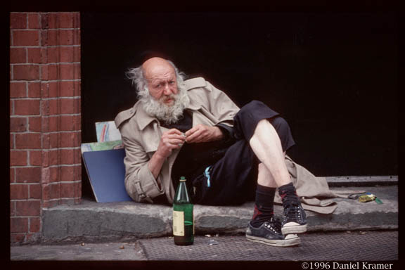
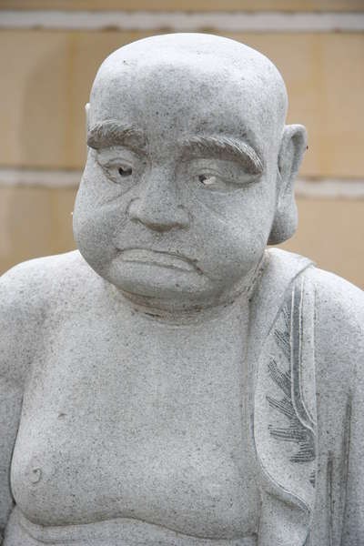
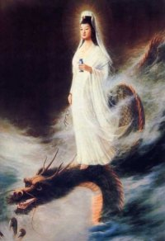
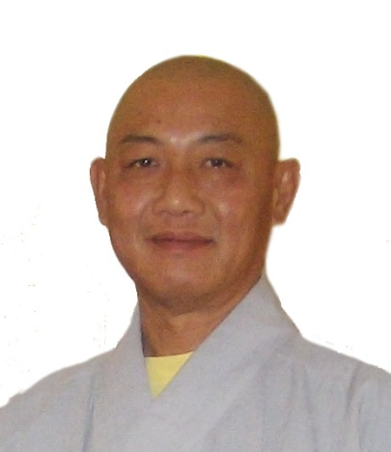
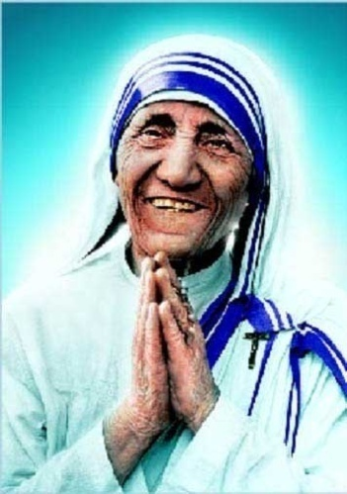
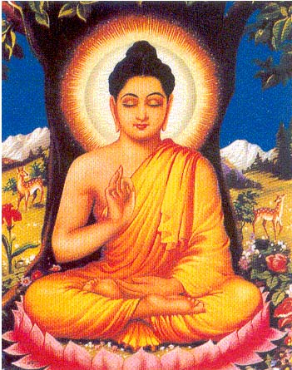
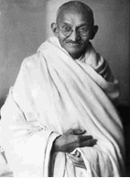
What is there beyond Self/I/Ego?
Arahat = Self Awareness
Definition: Detached from all
Bodhisattva
= Grand vow: Self Awareness, & entice others to Self Awareness
Definition: self sacrifice for the benefits of others
Mahasattva / Buddha = Completion of Grand Vow
Definition: Bring hope to the hopeless

Slide 32
Metaphysical view of Self
Macro view
I am an integral part of the Universe.
My compassion converts this inanimate Universe into a sphere of beings progressing in consciousness level.
The Universe rely on me to feel, think, comprehend and become aware of itself.
Micro view
I am composed of numerous cells in metabolic flux.
My new life is constantly changing. I am not the same Self as one minute ago.

Slide 33
Physical View of Self
Macro
Back-track, evolution, behavioral anthropology
Micro
Organ transplant means each organ is an independent living entity
Microbial physiology and symbiosis: 10-times more microbial cells than human cells; 100-times more microbial gene associated with the human body; implicated in digestion, inflammatory bowel disease (traveler's diarrhea), cancer, food allergy, anxiety, depression, autism…
March 16, 2013
Review lesson 1 - 4
33
33

Slide 34
बोधि Bodhi
Ultimate goal in Buddhism
Awakening is evolution of human consciousness in all aspects including religion, metaphysics, science and philosophy (To recognize the meaning of life)
Enlightenment is embracing these knowledge in totality and living out life wisely to its highest value. (To fulfil the value of life)

Slide 35
Thank you for being here
Mindfulness/relaxation
In body,
Mind, and
Spirit
Awareness

Slide 36
Your Roadmap to Enlightenment
Wisdom
Awareness
Knowledge

Slide 37
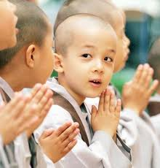
THE END
Thank You
37

Slide 38
智覺學苑
Buddhism in Modern Language
at
Pho-Hien Temple
Academy of Wisdom & Enlightenment (AWE)
www.AWE-edu.com

