Slide 1
Academy of Wisdom & Enlightenment (AWE)
UNDV Conference W5 - 17
How to Transcend Duality?
Tammy Cheng, CMLTO
Toronto, Canada
May 9th , 2014

Slide 2
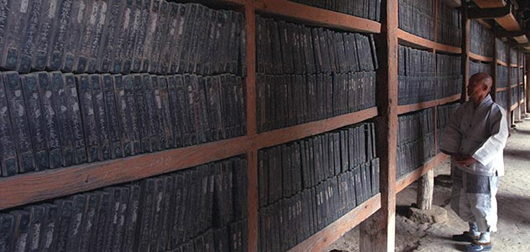
Tripitaka Volumes
Teachings for Transcending Duality
Where do I begin?

Slide 3
Teachings for Transcending Duality
Lankavatara Sutra Scroll #1, Chapter 1, Section 1, “Lecture on the Heart by All Tathagata” (楞伽阿跋多羅寶經卷第一,一切佛語心品第一之一) .
In the final chapter of the 6th Patriarch Platform Sutra.
In two places in the Avatamsaka Sutra [大方廣佛華嚴經]:
“Enter the dharma realm [入法界品]” Section 12 [善財童子第十二參].
Scroll #45, Asamkhya Article, Chapter 30 (卷四十五，阿僧祇品，第三十章) − the Tathagata’s instructions for the Bodhisattva Ruler of Heart (心王菩薩).

Slide 4
Let’s start from the very beginning

Slide 5
Sentient Beings are Born to Develop Duality Concepts
Sentient beings recognize phenomena by duality.
Realities are perceived in contrasting pairs: light/dark, hungry/full, hot/cold, happy/sad, black/white, male/female, life/death, good/evil, yes/no, heaven/hell, positive/negative, Yin/Yang, samsara/nirvana, etc.
The 6th Patriarch listed a total of 36 such duality pairs in the final Chapter of the Platform Sutra.

Slide 6
Disadvantages of Duality Thinking Mode
Habitually thinks in terms of:
Opposites
Mutually exclusive
Conflict
Fragmentation
Segregation
Separation
Split/divide
The world today!

Slide 7
Enlightened Beings Transcended Duality
Enlighten Thinking Holistic | Sentient Being Thinking Fragmented
Wholesome | Unhealthy
All-inclusive | Exclusion
Integration | Segregation
Unification | Separation
Totality | Split/divide
Open Mind

Slide 8
AWE Teaching Modules
Why are these teachings not popular?
The Tathagata teachings are too profound to grasp
Open your mind first before transcending duality
Bridges the gap by introducing the missing prerequisite prior to the Avatamsaka Sutra Module.
The Childhood Development Module
The 10^{n+1} Module
The 10² Module
The Avatamsaka Sutra Module

Slide 9
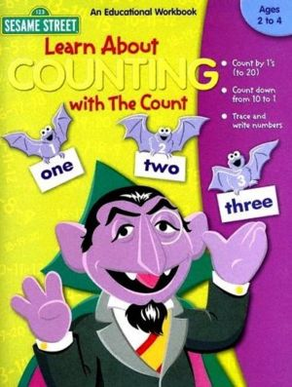
1. The Childhood Development Module
Numerical concept parallels intellectual maturation
Baby has no concept of numbers
Learn by play
Count
quantitative concept using numbers
Complex mathematics

Slide 10
Important points for intellectual maturation
Intelligence involves conceptual maturation from qualitative to semi-quantitative to quantitative.
Numbers are just numbers, no matter how simple or how complicated .
Mathematics, No matter how complex it seems, you can learn it if you choose to.

Slide 11
2. The 10^{n+1} Module
Unit | Log increments | Digits
Ten | 10 | 2
Hundred | 100 | 3
Thousands | 1000 | 4
Millions | 1,000,000 | 7
Billions | 1,000,000,000 | 10
Trillions | 1,000,000,000,000 | 13
Quadrillion | 1,000,0000,000,000,000 | 16
Gazillion | 1,000,000,000,000,000,000 | 19
zillion, jillion, and gazillion, are fictitious names
“Infinity” | 1,000,000,000,000,000,000,000 | 22

Slide 12
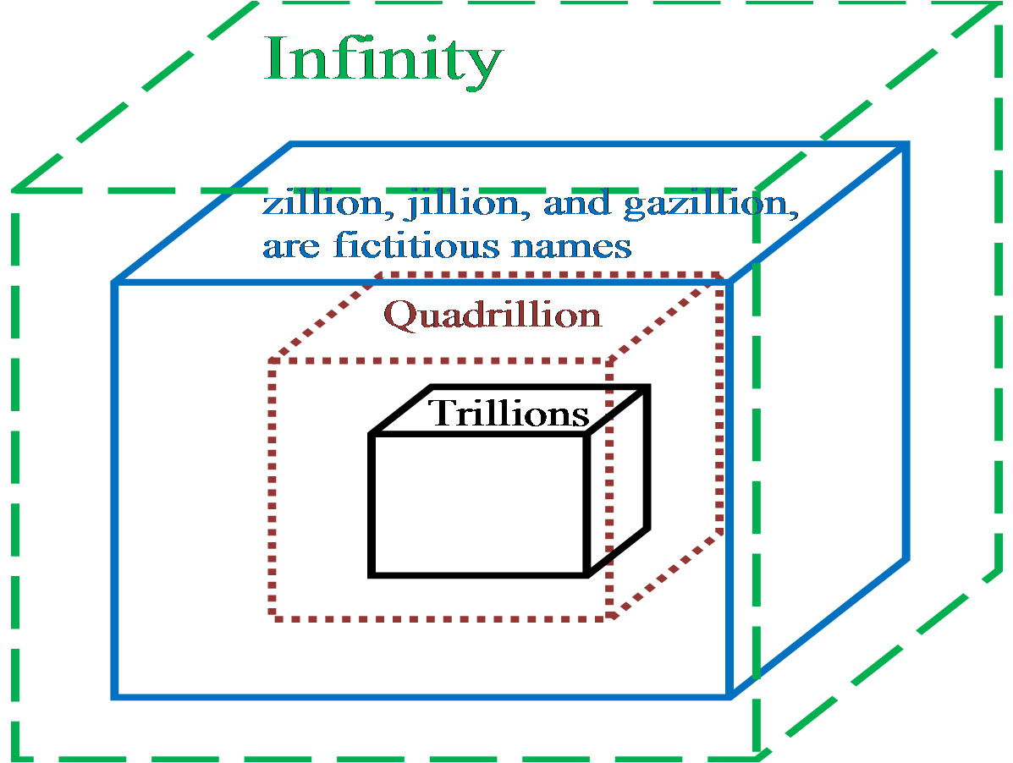
The Thinking Boxes
The 10^{n+1} series is a logical progression that has no end.
To stop the progression by
suddenly introducing the
concept of “infinity” at any step is entirely illogical.
By this logic, the entire concept of infinity is invalid.
The infinity thinking box can be anywhere depending on the individual.

Slide 13
The 10² Module
Units | Square Increment | Digits
Hundred | 10 x 10 = 100 | 3
Ten thousand | 100 x 100 = 10,000 | 5
Hundred million | 10,000 x 10,000 = 100,000,000 | 9
Hundred quadrillion | 100,000,000 x 100,000,000 = 10,000,000,000,000,000 | 17
“Infinity” | 10,000,000,000,000,000 x 10,000,000,000,000,000 = infinity | 33

Slide 14
4. The Avatamsaka Sutra Module
 | Avatamsaka Sūtra | Number of Digits
1 | 10,000,000 = 10 million = 1 koti | 8
2 | koti x koti = ayuta | 15
3 | ayuta x ayuta= niyuta | 29
4 | niyuta x niyuta = bimbara | 57
5 | bimbara x bimbara = kinkara | 113
6 | kinkara x kinkara = agara | 225
7 | agara x agara = pravara | 449
8 | pravara x pravara = mapara | 897
The first column designates every square step; the second column provides a unit of measurement for that product; the third column quantifies each infinitesimal number.

Slide 15
4. The Avatamsaka Sutra Module
 | Avatamsaka Sūtra | Number of Digits
97 | aupamya x aupamya = incalculable | 554597137599850363154807652353
98 | incalculable x incalculable = incalculable² | 1109194275199700726309615304705
99 | incalculable² x incalculable² = incalculable⁴ | 2218388550399401452619230609409
100 | incalculable⁴ x incalculable⁴ = measureless | 4436777100798802905238461218817
101 | measureless x measureless = measureless² | 8873554201597605810476922437633
102 | measureless² x measureless² = measureless⁴ | 17747108403195211620953844875265
103 | measureless⁴ x measureless⁴ = boundless | 35494216806390423241907689750529
104 | boundless x boundless = boundless² | 70988433612780846483815379501057

Slide 16
Mathematic Logic & Expansion of Mind Set
Finite = Measurable = unit
Infinite = immeasurable = no unit
Introduce additional units to measure large numbers, the immeasurable becomes measurable
Abstract concepts such as infinity (a qualifier) can be quantified by introducing new units of measurement.
Break through duality (finite and infinite are opposites by definition)
Opposites are product of small mindset
X is inside the box, Y is outside the box, therefore they are opposites. No box, no opposites (think outside box)

Slide 17
AWE Method
Use counting units to measure one’s Zen:
Emotional resistance to accomplish a task
Ego’s resistance to Tathagata’s teaching
Visualize that infinity is a concept created by the close mind or limited thinking box
Focus/concentration/attention span (Samadhi)
Life force (Zen serenity power)

Slide 18
Summary
Turning the Dharma Wheel forward − to extract the wisdom from the sutra and elucidates the teachings using modern languages and methods:
How to open our minds
From qualify to quantify
How to transcend duality
Resolved opposites/conflicts
Attain equanimity by going from relative to absolute

Slide 19
Conclusion
“How to Transcend Duality” is AWE’s third lecture in Year-1 university curriculum.
This talk subscribes to two conference sub-themes:
Buddhist Education and University Level Curriculum
Peace-building and Post-Conflict Recovery

Slide 20
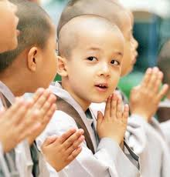
www.AWE-edu.com
FIN
Thank You for Your Attention

